Slide 1
Time of Travel Calculator
Cpet_499 Final Project
By: Garrett Leckrone and Trey Lohman

Slide 2
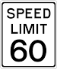
Idea for Application
60 MPH makes time of arrival (TOA) easy
The risk of making it on time
The reality of how late one might be
Reality makes TOA harder to determine
Number of stops
The driving environment
Speed Limit
How above or below the speed limit

Slide 3
Problems and Solutions
The png files needed to be saved as JPEG files.
The background for the editText box.
There needed to be a speed limit section added in.
Using Relative Layout instead of Absolute Layout.
Sending the file back and fourth for editing.
The radio buttons needed to be saved as a radio group.
Text color for the editText needed to be visible.

Slide 4
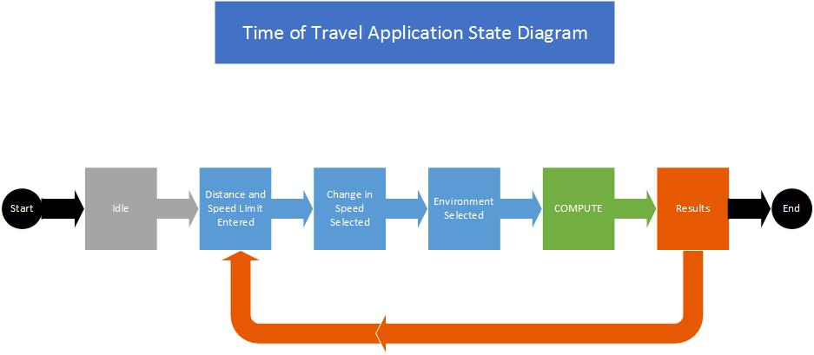
System Block Diagram

Slide 5
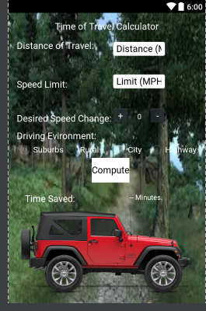
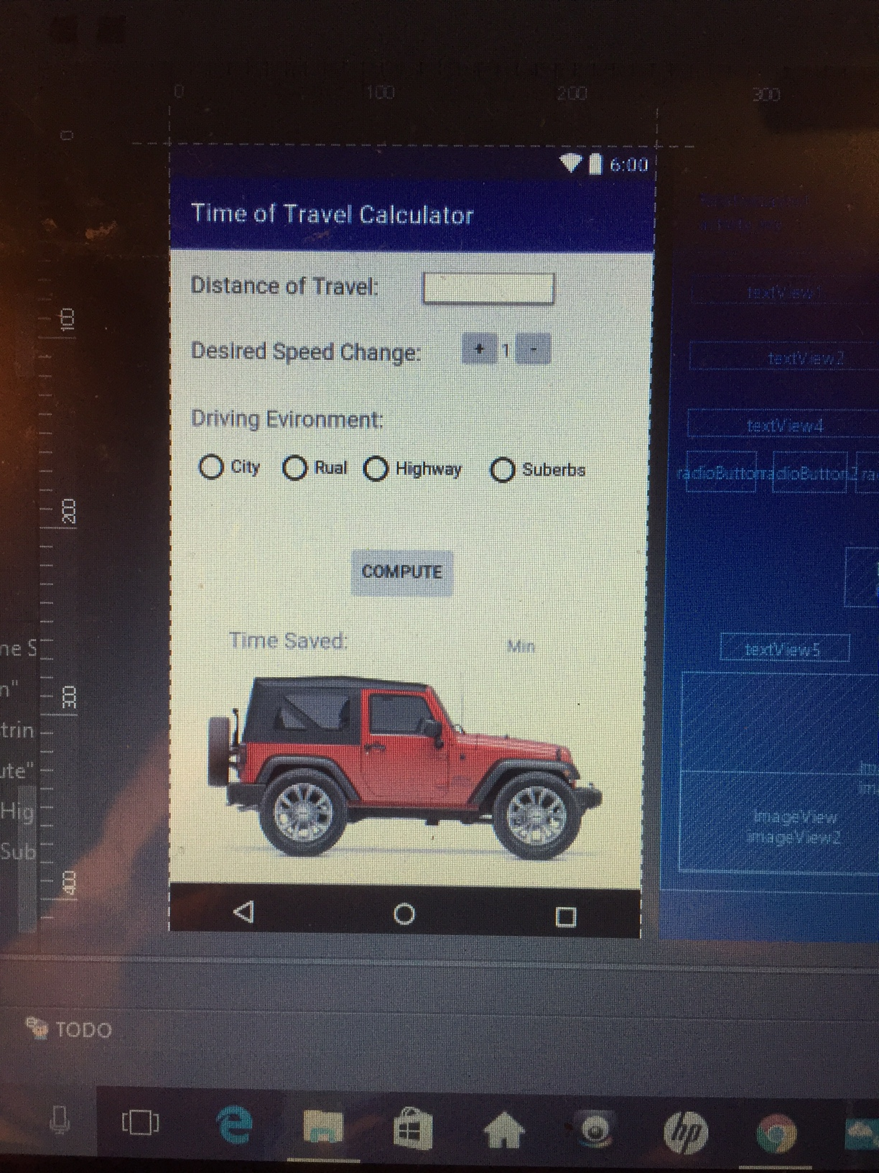
GUI Set up: Before & After class implementation (Relative Layout )

Slide 6
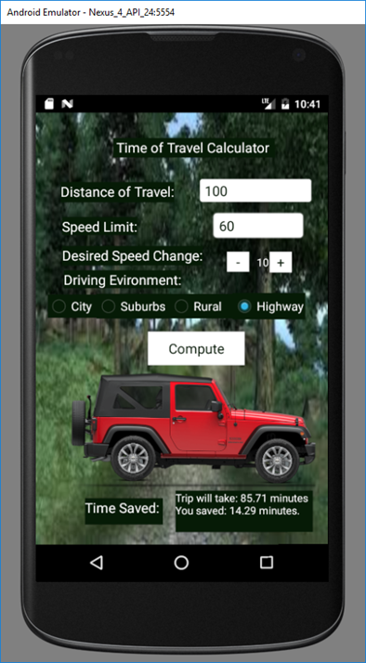
GUI set up: Final Product (Absolute Layout)

Slide 7
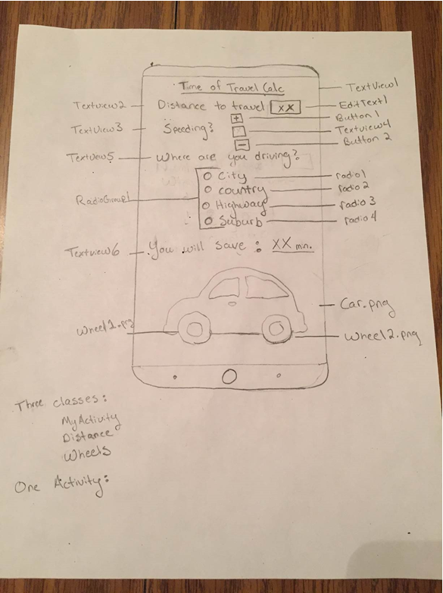
User Interphase (diagram)

Slide 8
Major Classes

